Slide 1
Customer Analytics
Lecture 1

Slide 2
Test & Roll

Slide 3

E-Beer
E-Beer sells beer over the Internet and currently has about 50,000 customers
A customer selects the favorite brand, pays, and within 1 hour the ordered amount of beer is delivered at the specified address
To boost sales, E-Beer developed a catalog to send to their customers.
Each catalog contains a flyer to remind customers of the offered service and a key ring with the name and web address of the company

Slide 4

Campaign costs
Each mailing costs $\text{€} 1.50$
Sending it to all customers would mean total costs of
$$\text{€} 1.50×50000=\text{€} 75000$$

Slide 5
Is it worth it? Do benefits > costs?
The problem is that the benefit is uncertain!

Slide 6
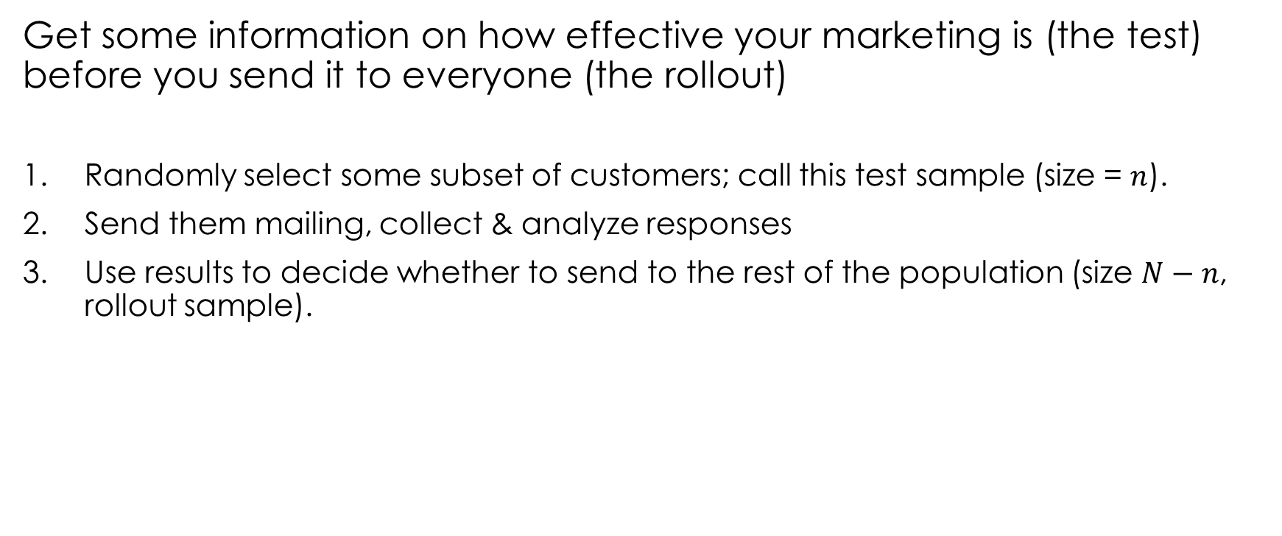


Test & Roll experiments
Get some information on how effective your marketing is (the test) before you send it to everyone (the rollout)
Randomly select some subset of customers; call this test sample (size = $n$).
Send them mailing, collect & analyze responses
Use results to decide whether to send to the rest of the population (size $N−n$, rollout sample).
Test
Sample
Rollout Sample
$$n$$
$$N−n$$
Notes:
Tactical marketing

Slide 7
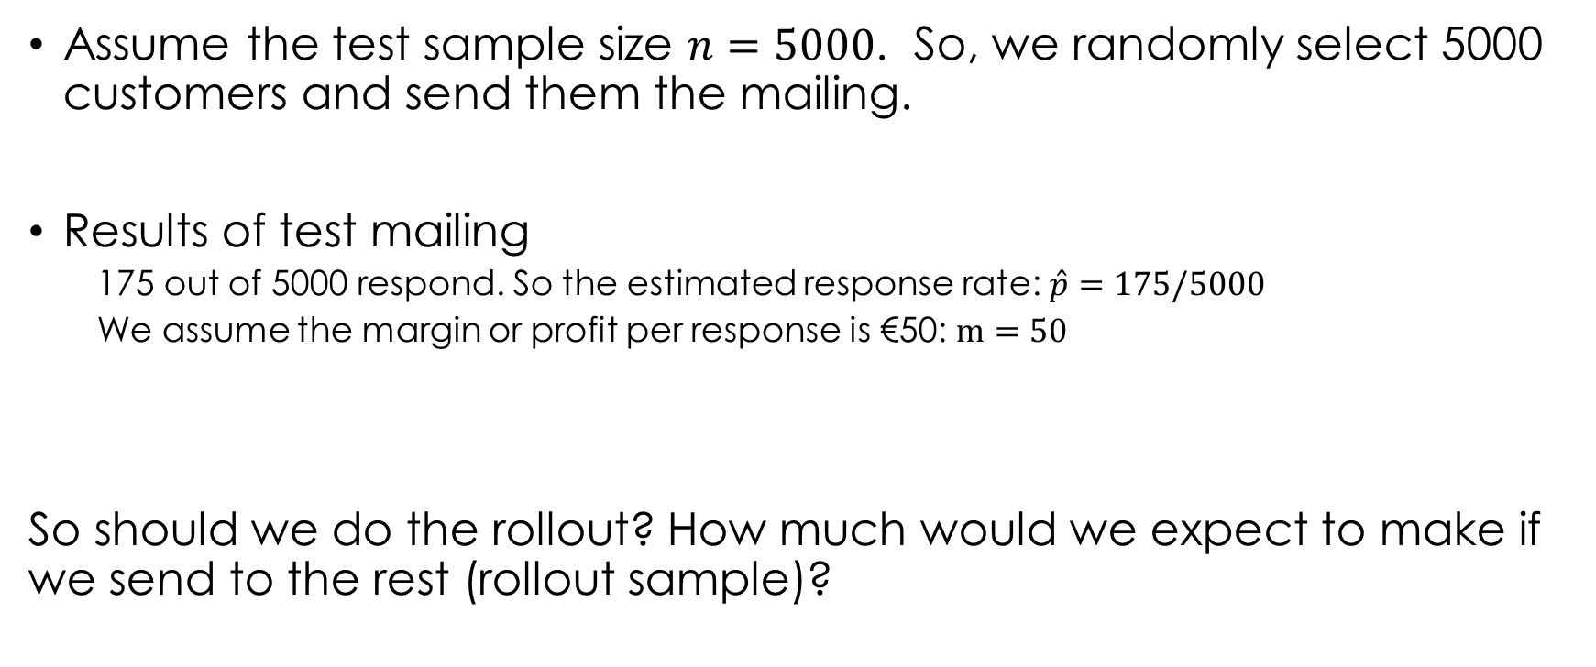
Results of test
Assume the test sample size $n=5000$. So, we randomly select 5000 customers and send them the mailing.
Results of test mailing
175 out of 5000 respond. So the estimated response rate: $\hat{p}=175/5000$
We assume the margin or profit per response is €50: $m=50$
So should we do the rollout? How much would we expect to make if we send to the rest (rollout sample)?

Slide 8
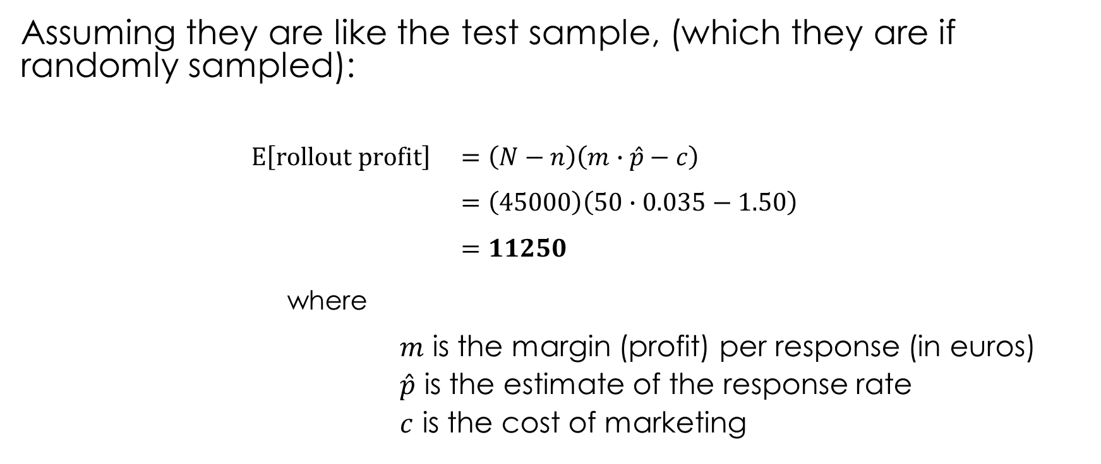
Expected rollout profits
Assuming they are like the test sample, (which they are if randomly sampled):
$$E\left[rollout profit\right] =\left(N−n\right)\left(m∙\hat{p}−c\right) \\ =\left(45000\right)\left(50∙0.035−1.50\right) \\ =11250$$
where
$m$ is the margin (profit) per response (in euros)
$\hat{p}$ is the estimate of the response rate
$c$ is the cost of marketing
# rollout
customers
profit per customer

Slide 9
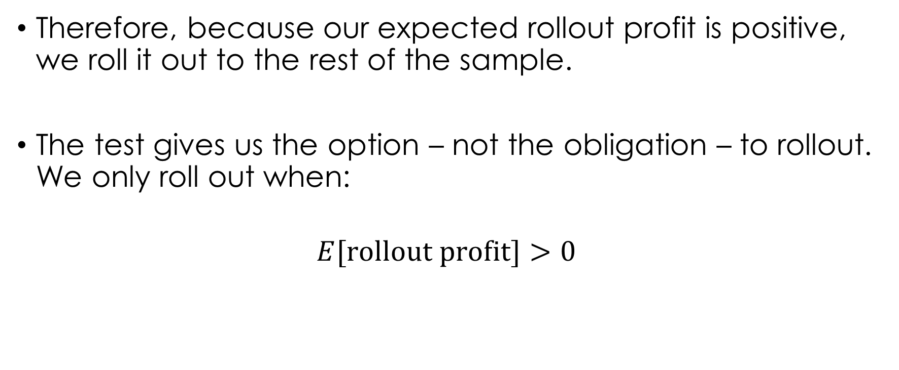
Option value
Therefore, because our expected rollout profit is positive, we roll it out to the rest of the sample.
The test gives us the option – not the obligation – to rollout. We only roll out when:
$$E[\text{rollout} \text{profit}\text{]}>0$$
Notes:
in the example, what’s the threshold?

Slide 10

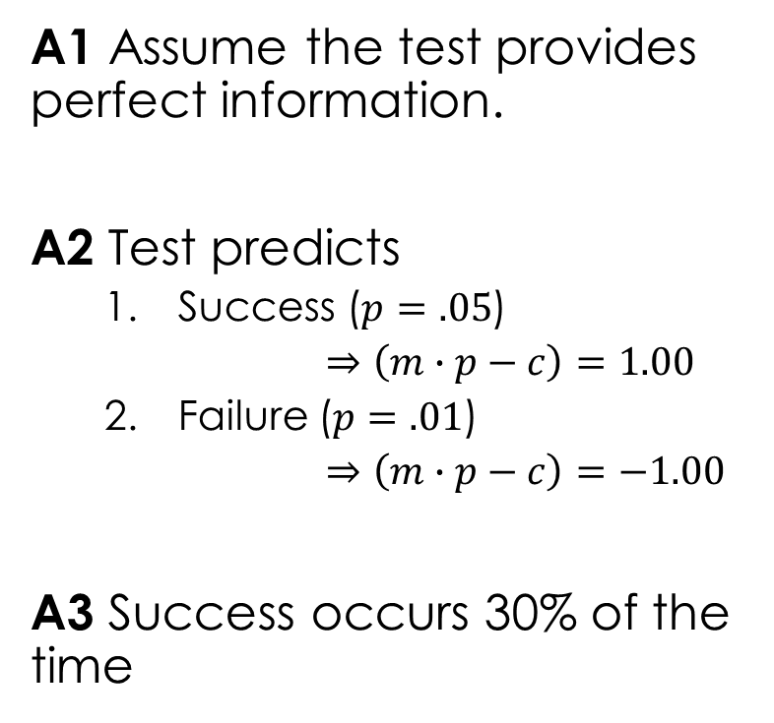





How big is the option value?
$=$ 0 (why?)
No test
A1 Assume the test provides perfect information.
A2 Test predicts
Success ($p=.05$)
$⇒\left(m∙p−c\right)=1.00$
Failure ($p=.01$)
$⇒\left(m∙p−c\right)=−1.00$
A3 Success occurs 30% of the time
Profit comes from both test and rollout
Decision
mail
Success
$$= 50000$$
$$0.3$$
(test + rollout)
Test
Test
says
No mail
Failure
$$=−5000$$
$$0.7$$
(only test)
$$\text{Value} \text{of} \text{test}=E[\text{profit}|\text{test}]−E[\text{profit}|\text{no} \text{test}]$$
$$=0.3∙\left(50000\right)+0.7∙\left(−5000\right)−0$$
$$=11500$$
BKN 9.2

Slide 11
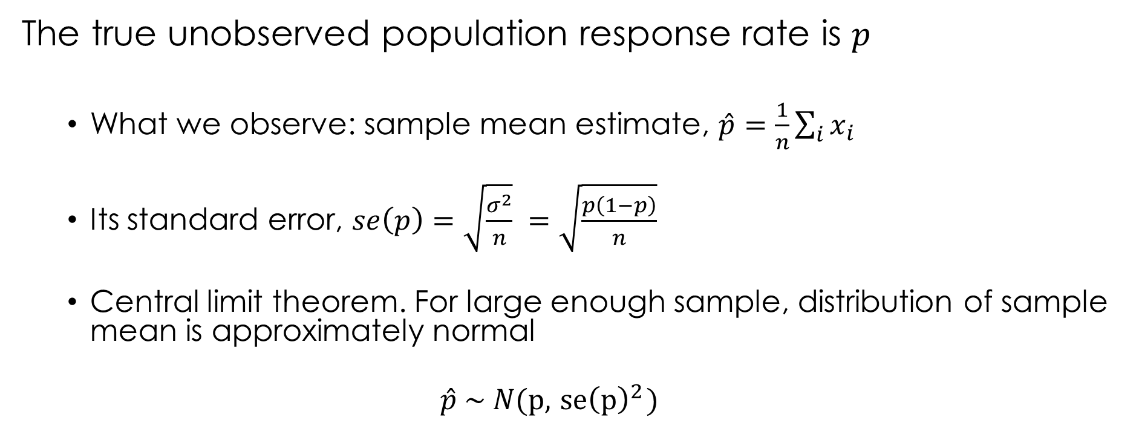
Uncertainty
The true unobserved population response rate is $p$
What we observe: sample mean estimate, $\hat{p}=\frac{1}{n}\sum_{i}{x_{i}}$
Its standard error, $se\left(p\right)=\sqrt{\frac{σ^{2}}{n}} =\sqrt{\frac{p\left(1−p\right)}{n}}$
Central limit theorem. For large enough sample, distribution of sample mean is approximately normal
$$\hat{p} \sim N(p, { se\left(p\right)}^{2})$$

Slide 12

What’s the probability we make a mistake?
$$P\left(\hat{p}<0.03\right)=.027$$

Slide 13
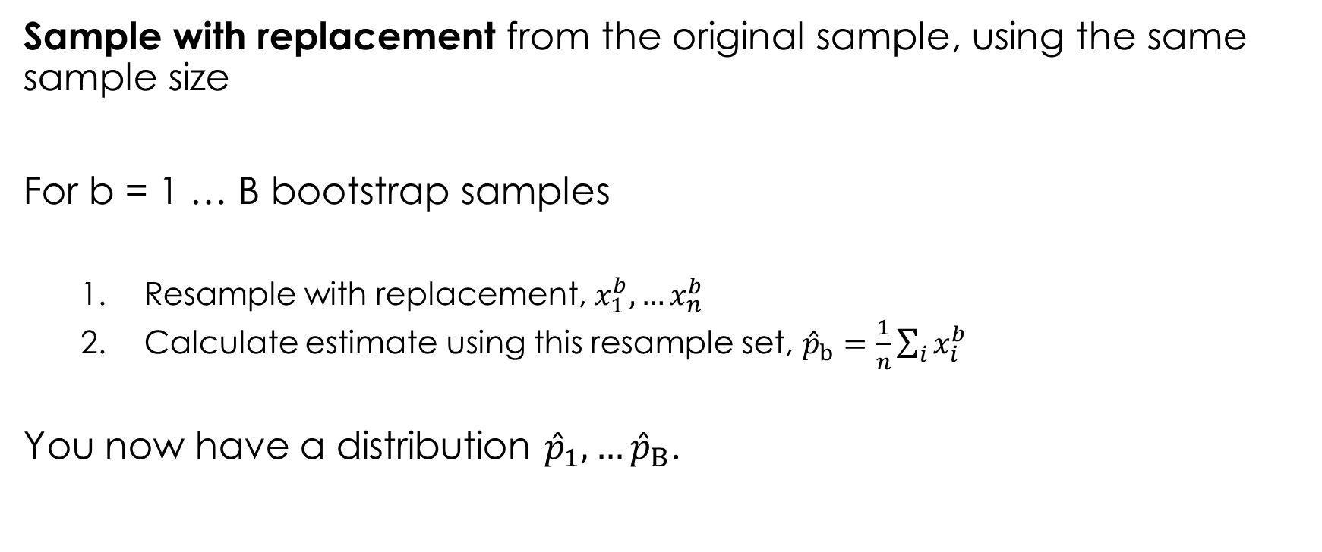
Bootstrap
Sample with replacement from the original sample, using the same sample size
For b = 1 … B bootstrap samples
Resample with replacement, $x_{1}^{b}, …x_{n}^{b}$
Calculate estimate using this resample set, ${\hat{p}}_{b}=\frac{1}{n}\sum_{i}{x_{i}^{b}}$
You now have a distribution ${\hat{p}}_{1}, …{\hat{p}}_{B}$.

Slide 14
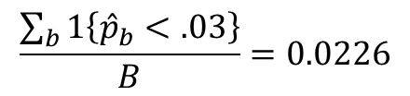
$$\frac{\sum_{b}{1\left\{{\hat{p}}_{b}<.03\right\}}}{B}=0.0226$$

Slide 15
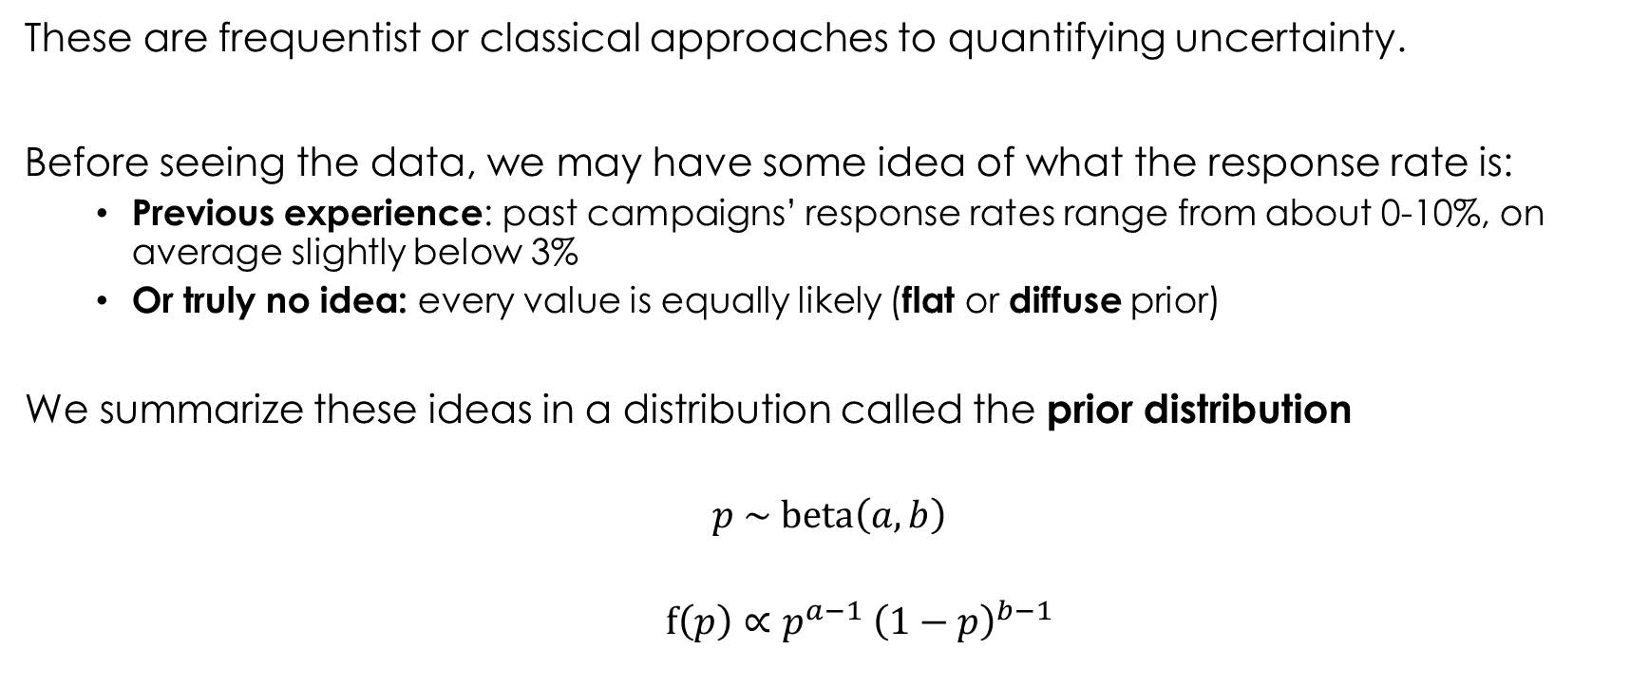
Bayesian approach
These are frequentist or classical approaches to quantifying uncertainty.
Before seeing the data, we may have some idea of what the response rate is:
Previous experience: past campaigns’ response rates range from about 0-10%, on average slightly below 3%
Or truly no idea: every value is equally likely (flat or diffuse prior)
We summarize these ideas in a distribution called the prior distribution
$$p \sim \text{beta}\left(a,b\right)$$
$$f\left(p\right)∝p^{a−1} {\left(1−p\right)}^{b−1}$$

Slide 16
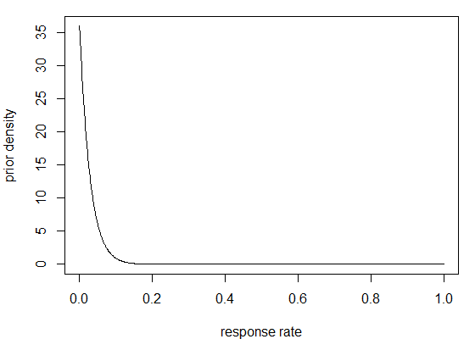
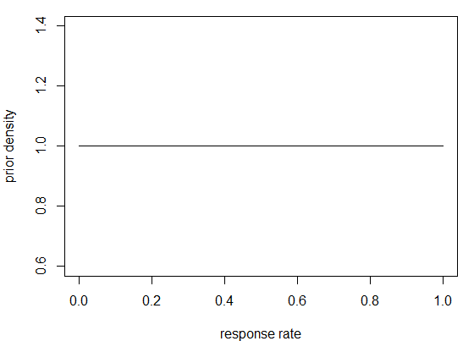


Prior density
$$(a=1,b=36)$$
$$(a=1,b=1)$$
Previous experience
Flat or diffuse prior
Notes:
Describing how likely the response rates are.

Slide 17
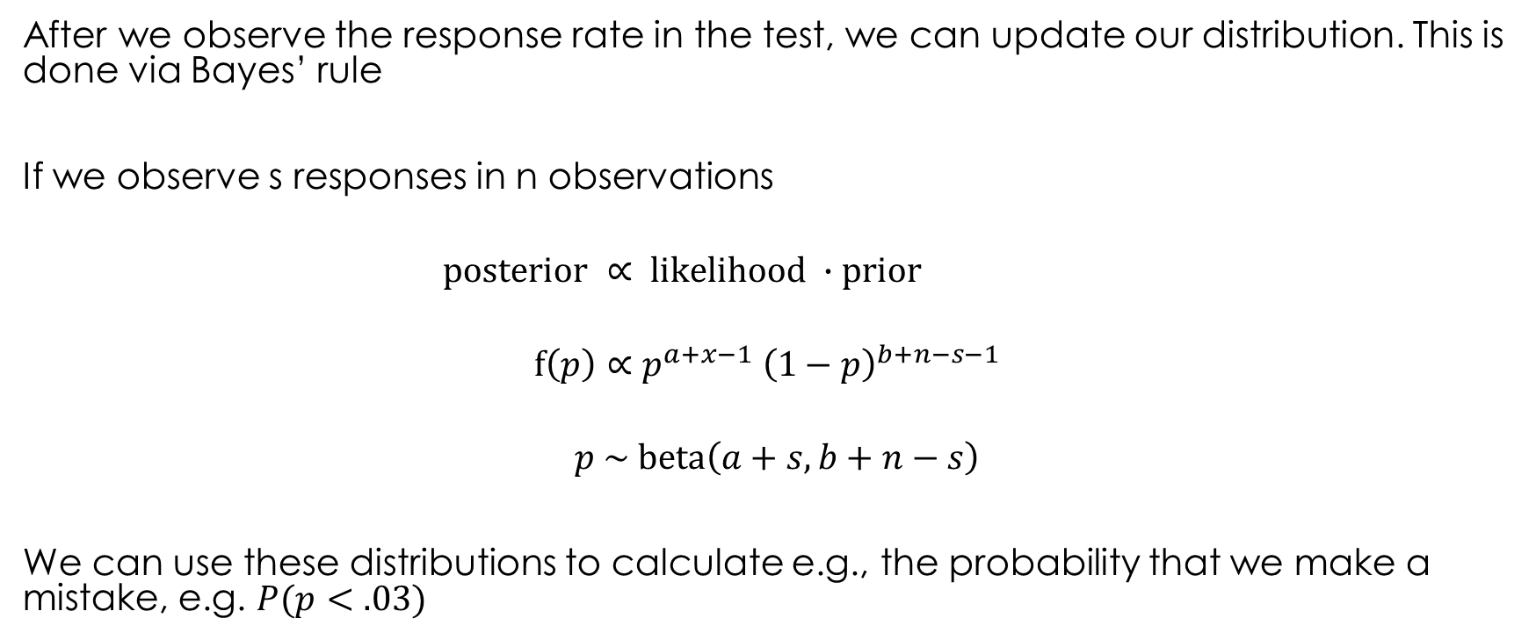
Posterior distribution for the response rate
After we observe the response rate in the test, we can update our distribution. This is done via Bayes’ rule
If we observe s responses in n observations
$$\text{posterior} ∝ \text{likelihood} ∙\text{prior}$$
$$f\left(p\right)∝p^{a+x−1} {\left(1−p\right)}^{b+n−s−1}$$
$$p \sim \text{beta}\left(a+s, b+n−s\right)$$
We can use these distributions to calculate e.g., the probability that we make a mistake, e.g. $P(p<.03)$
This is called the Beta-Binomial model.
Notes:
Beta is the prior; binomial is the likelihood.

Slide 18
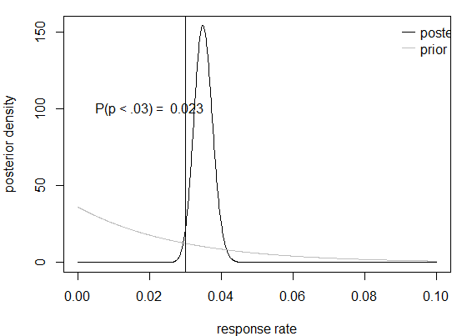

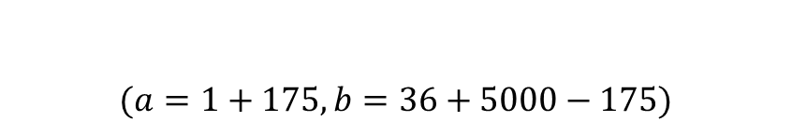
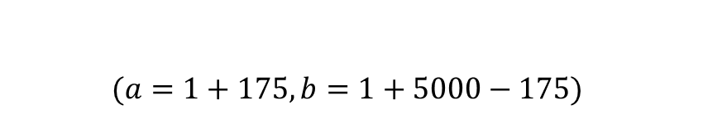
Posterior density
$$p \sim \text{beta}\left(a+s, b+n−s\right)$$
$$(a=1+175,b=36+5000−175)$$
$$(a=1+175,b=1+5000−175)$$
The more data you have, the less the prior matters
Notes:
Describing how likely the response rates are.

Slide 19
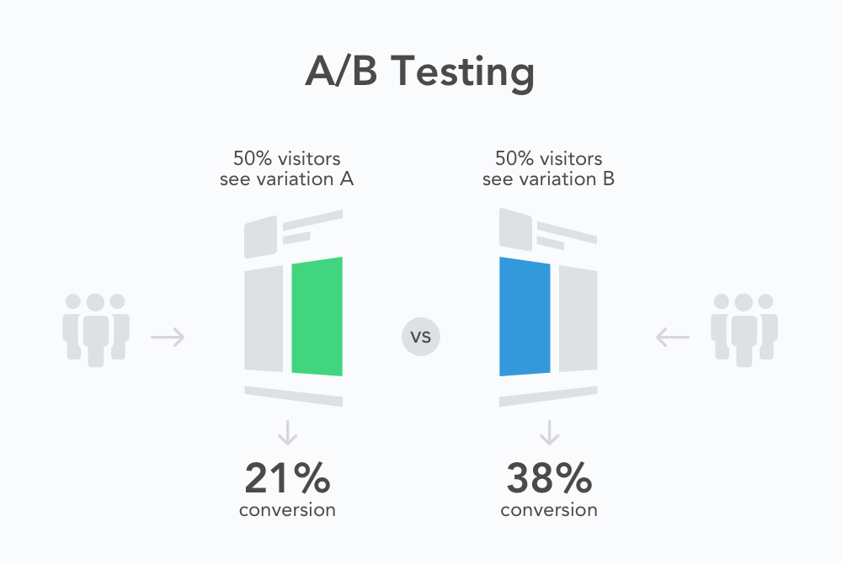
You can use this to compare two versions

Slide 20
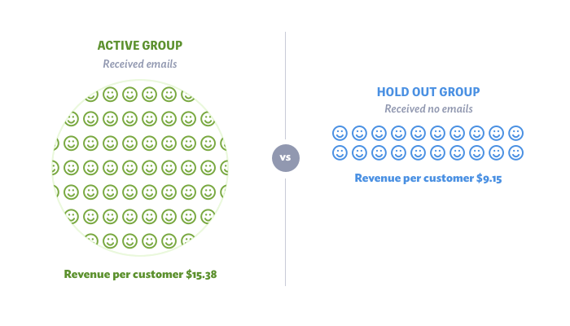
Holdout tests

Slide 21
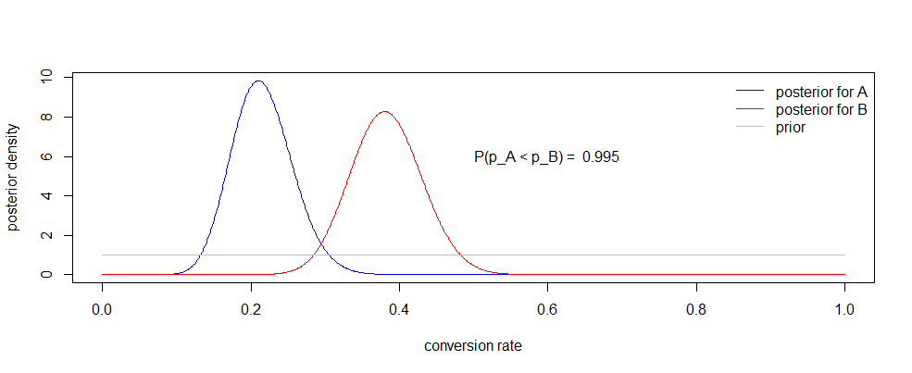
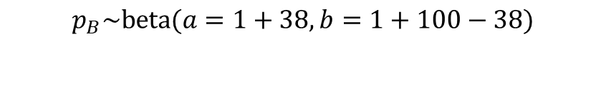
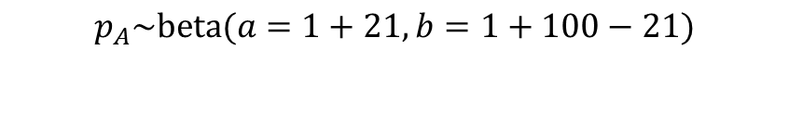
$$p \sim \text{beta}\left(a+s, b+n−s\right)$$
$$p_{A}\sim \text{beta}(a=1+21,b=1+100−21)$$
$$p_{B}\sim \text{beta}(a=1+38,b=1+100−38)$$
set.seed(19312) p_A <-rbeta(n = 10000, shape1 = 1+21, shape2 = 1+100−21) p_B <-rbeta(n = 10000, shape1 = 1+38, shape2 = 1+100-38)
sum(p_A<p_B)/10000

Slide 22
Example
You collect data from an A/B test comparing the time users spend on your website for two versions of the homepage. A summary of the data looks like this:
Ver. Viewers Avg. Time St. Dev.
A 500 5.40 1.97
B 500 5.44 2.11
It looks like B keeps users on the site longer, but how sure are we that B produces longer visits on average? We’ve only seen 500 visitors in each group.

Slide 23


Continuous data
Suppose the data are continuous, like minutes or profits, instead of binary {0,1} data like responses or clicks.
Likelihood ($s$ is known)
$$y_{i} \sim \text{N}\left(m,s^{2}\right)$$
Prior
$$m \sim \text{N}\left(μ_{0},σ_{0}^{2}\right)$$
Posterior (*)
$$m \sim \text{N}\left(μ,σ^{2}\right)$$
$$σ=\sqrt{{\left(\frac{1}{σ_{0}^{2}}+\frac{n}{s^{2}}\right)}^{−1}}$$ | $$μ=σ^{2}\left(\frac{μ_{0}}{σ_{0}^{2}}+\frac{n \overline{y}}{s^{2}}\right)$$
Normal-Normal model

Slide 24
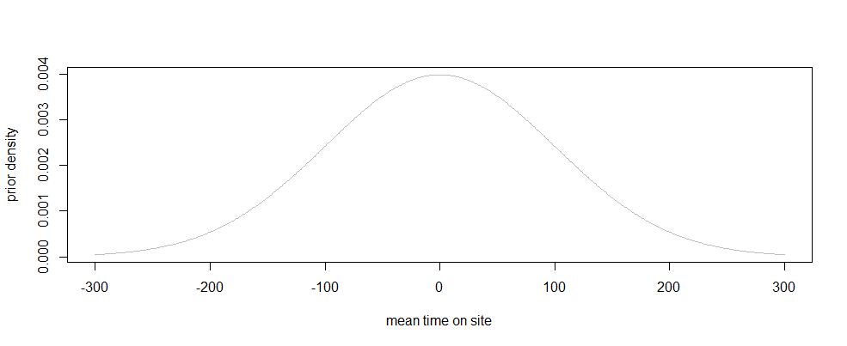
Prior
Both groups have the same diffuse prior, mean time on site ($m$)
$$m_{A},m_{B} \sim \text{N}\left(μ_{0}=0,σ_{0}^{2}={100}^{2}\right)$$

Slide 25

Posteriors
$$m_{A} \sim \text{N}\left(μ≈{\overline{y}}_{A},σ^{2}≈\frac{s^{2}}{n_{A}}\right)$$
The posterior is the likelihood because the prior is so diffuse.

Slide 26
Posterior

Slide 27
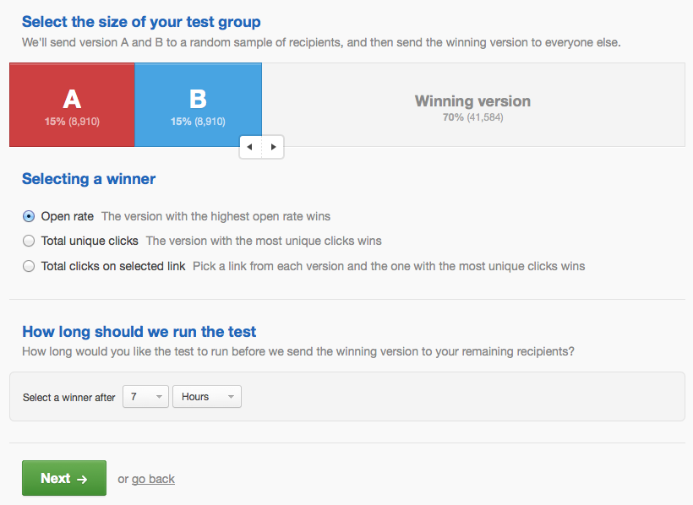
Typical A/B email test setup screen

Slide 28
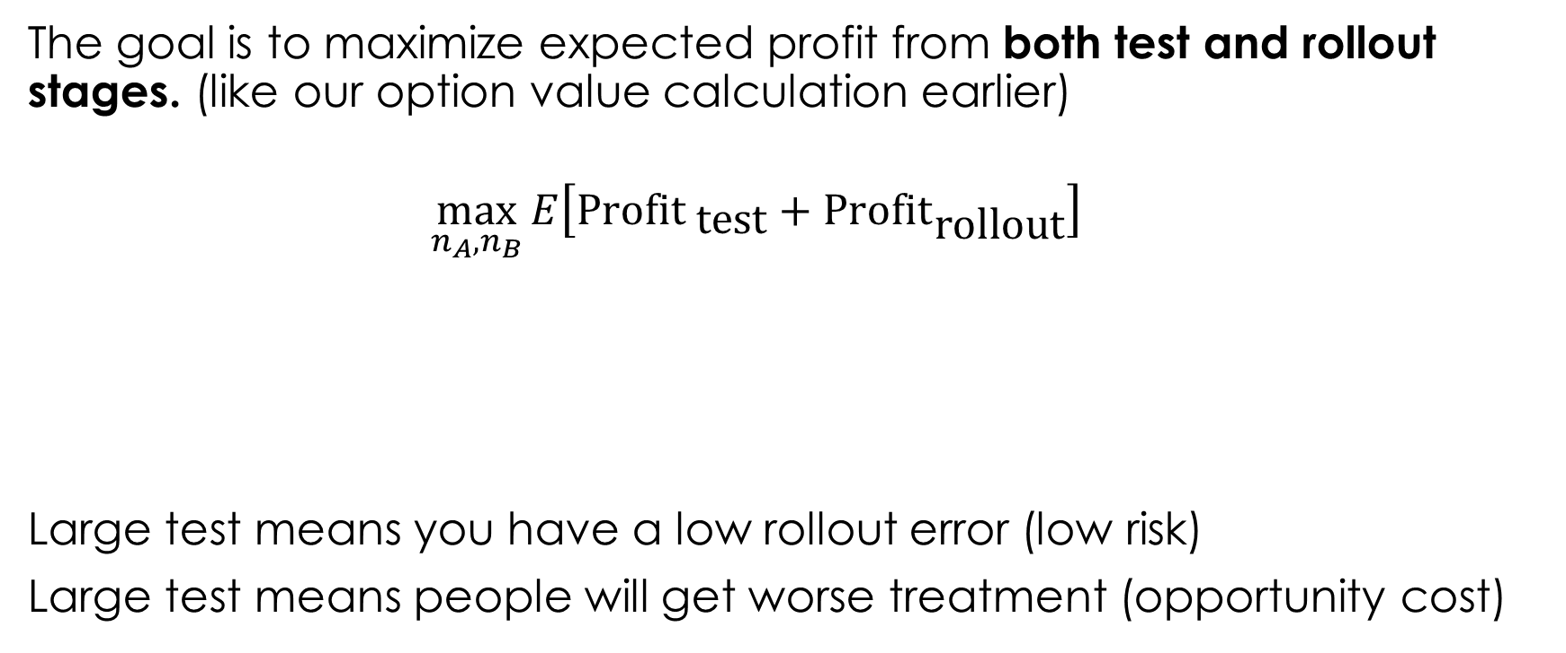



How big should the test be?
The goal is to maximize expected profit from both test and rollout stages. (like our option value calculation earlier)
$$\max_{n_{A}, n_{B}}{E\left[{\text{Profit} }_{\text{test}}+{Profit}_{\text{rollout}}\right]}$$
Large test means you have a low rollout error (low risk)
Large test means people will get worse treatment (opportunity cost)
Test
A
Test
B
Rollout
$$n_{A}$$
$$n_{B}$$
$$N−n_{a}−n_{b}$$
Feit and Berman (2019)
Notes:
We’re going to use this normal-normal model

Slide 29

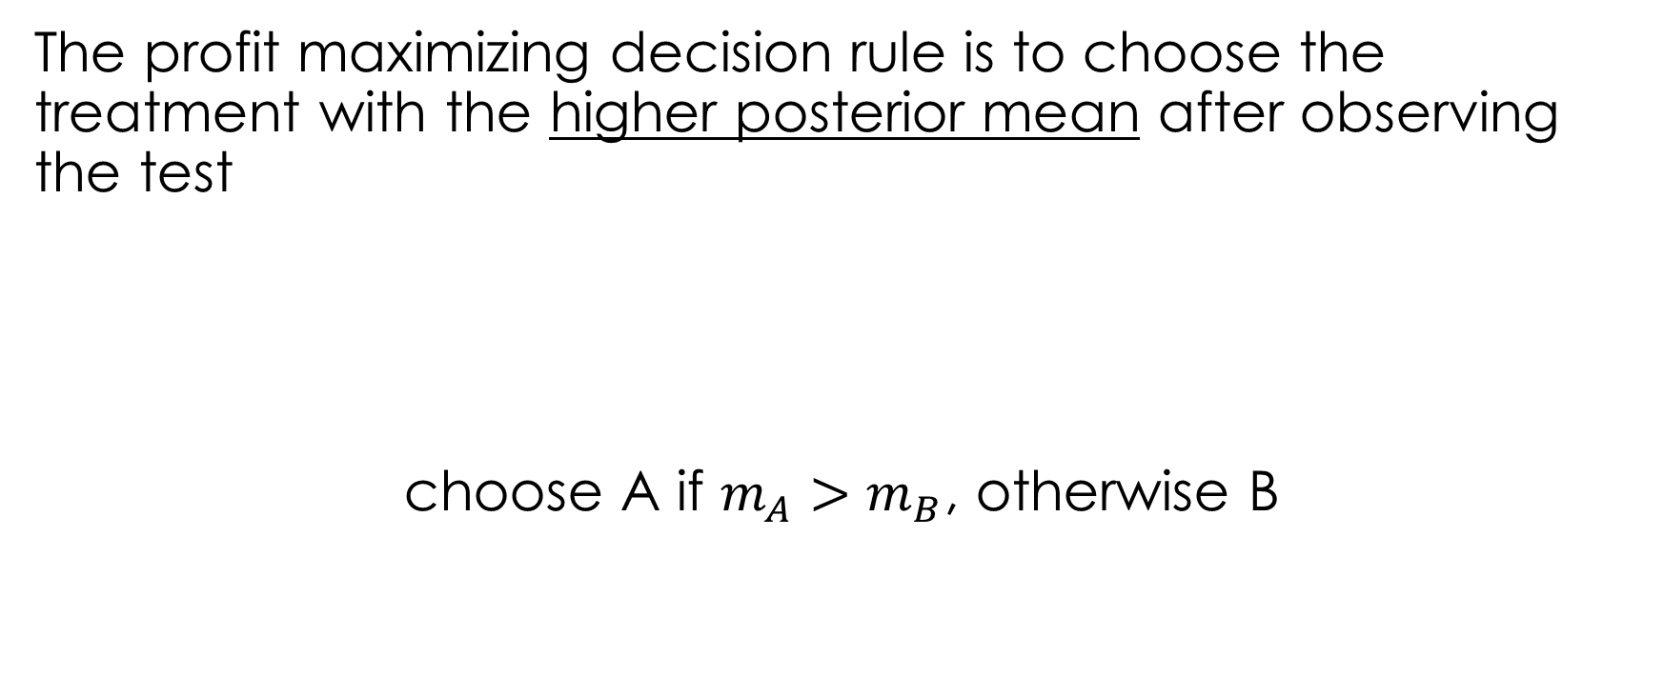


Decision rule
The profit maximizing decision rule is to choose the treatment with the higher posterior mean after observing the test
choose A if $m_{A}>m_{B}$, otherwise B
Calculate posterior mean
Test
A
Test
B
$$m_{A},{ m}_{B}$$
$$n_{A}$$
$$n_{B}$$

Slide 30
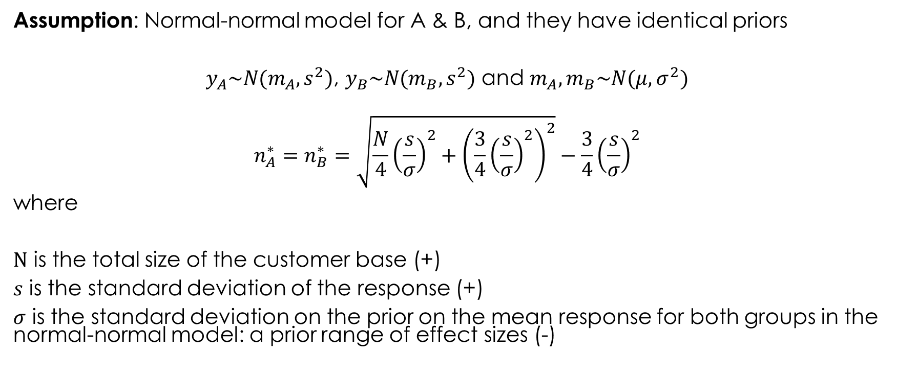
Optimal sample size
Assumption: Normal-normal model for A & B, and they have identical priors
$y_{A}\sim N(m_{A},s^{2})$, $y_{B}\sim N(m_{B},s^{2})$ and $m_{A}, m_{B}\sim N(μ,σ^{2})$
$$n_{A}^{∗}=n_{B}^{∗}=\sqrt{\frac{N}{4}{\left(\frac{s}{σ}\right)}^{2}+{\left(\frac{3}{4}{\left(\frac{s}{σ}\right)}^{2}\right)}^{2}}−\frac{3}{4}{\left(\frac{s}{σ}\right)}^{2}$$
where
$N$ is the total size of the customer base (+)
$s$ is the standard deviation of the response (+)
$σ$ is the standard deviation on the prior on the mean response for both groups in the normal-normal model: a prior range of effect sizes (-)
Feit and Berman (2019)
Notes:
s/sigma is noise/(potential signal): s is variability in response; sigma is the a priori range of effect sizes.

Slide 31
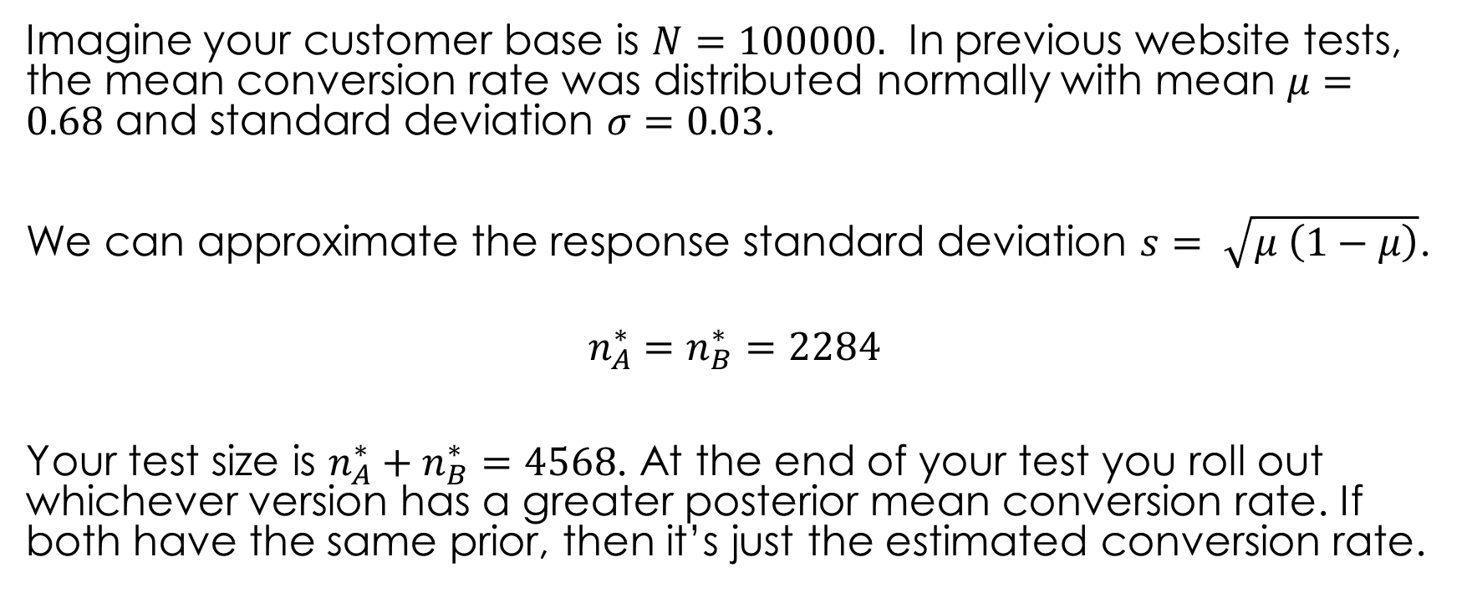
Example
Imagine your customer base is $N=100000.$ In previous website tests, the mean conversion rate was distributed normally with mean $μ=0.68$ and standard deviation $σ=0.03$.
We can approximate the response standard deviation $s= \sqrt{μ \left(1−μ\right)}$.
$$n_{A}^{∗}=n_{B}^{∗}=2284$$
Your test size is $n_{A}^{∗}+n_{B}^{∗}=4568$. At the end of your test you roll out whichever version has a greater posterior mean conversion rate. If both have the same prior, then it’s just the estimated conversion rate.

Slide 32

Extensions
The two treatments come from different priors (e.g., holdout test)
$y_{1}\sim N(m_{1},{100}^{2})$, $y_{2}\sim N\left(m_{2},{200}^{2}\right),$
$m_{1}\sim N(9,{10}^{2})$,${ m}_{2}\sim N(30,{20}^{2})$
No closed-form solution, but can numerically solve
$$n_{1}^{∗}= 642$$
$$n_{2}^{∗}=2284$$
We expect Treatment 2 to be better, so we allocate more tests.

